Slide 1

BUDGET BYTES
Created by Leyla Ahmed, Chelsea Dacones, Caroline El Jazmi & Abi Gutierrez
Notes:
Caroline

Slide 2
TABLE OF CONTENTS
01
INTRODUCTION
02
OVERVIEW
03
DESIGN
04
PROTOTYPE DEMO
05
CHALLENGES
Notes:
Caroline - Read table of contents to give overview of presentation structure

Slide 3
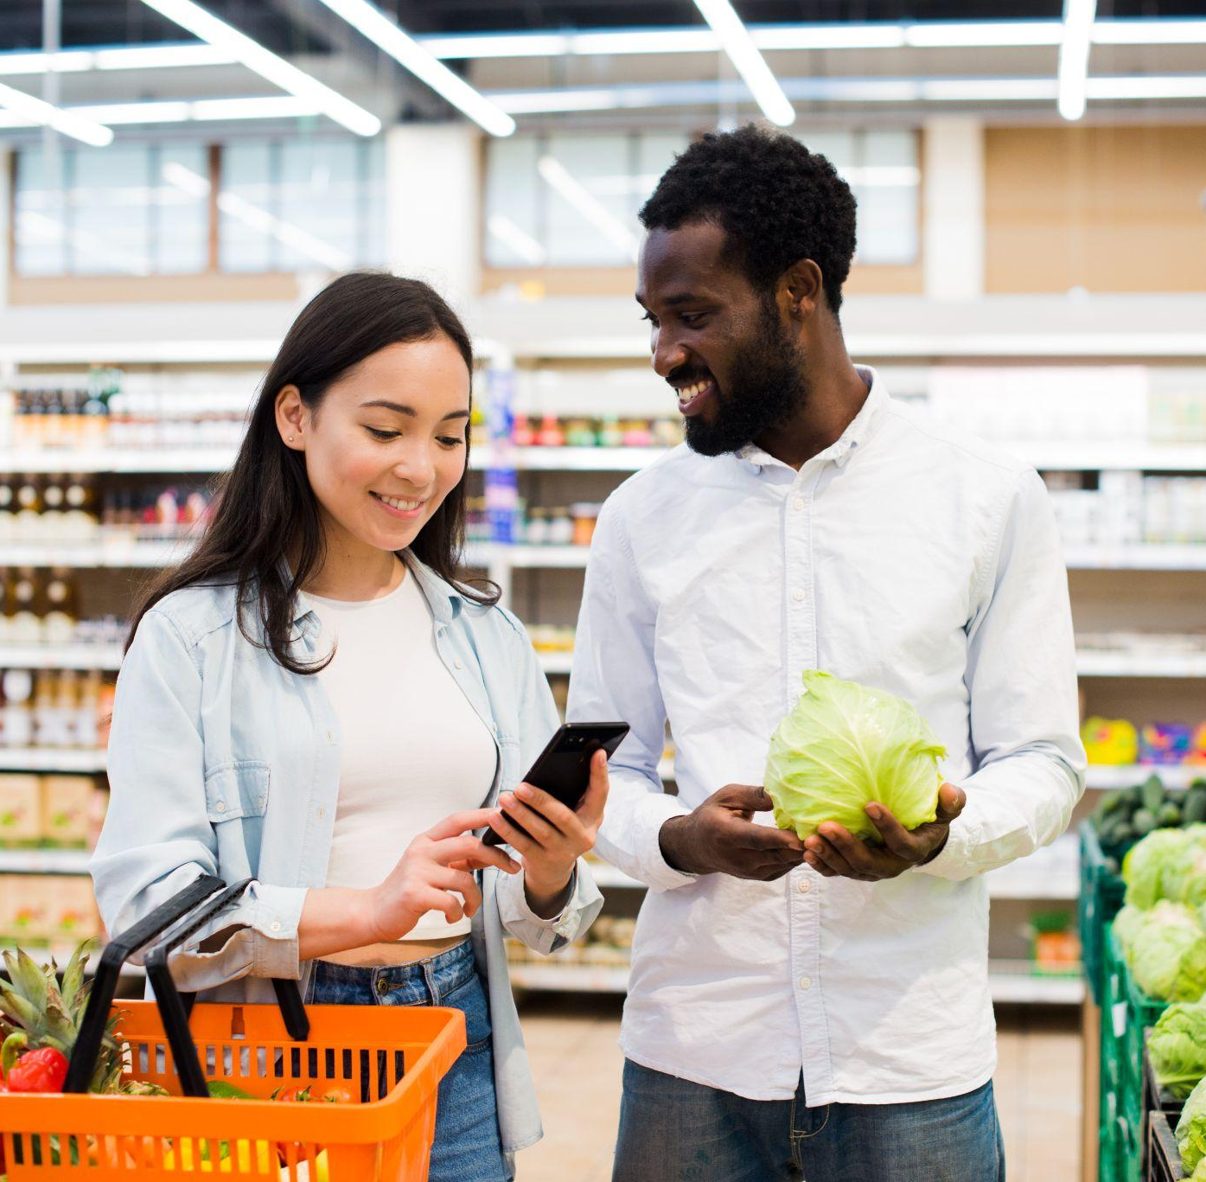
01
INTRODUCTION
Notes:
Caroline Introduce our RESTful web application - we designed a culinary assistant to aid users in finding easy, affordable recipes

Slide 4
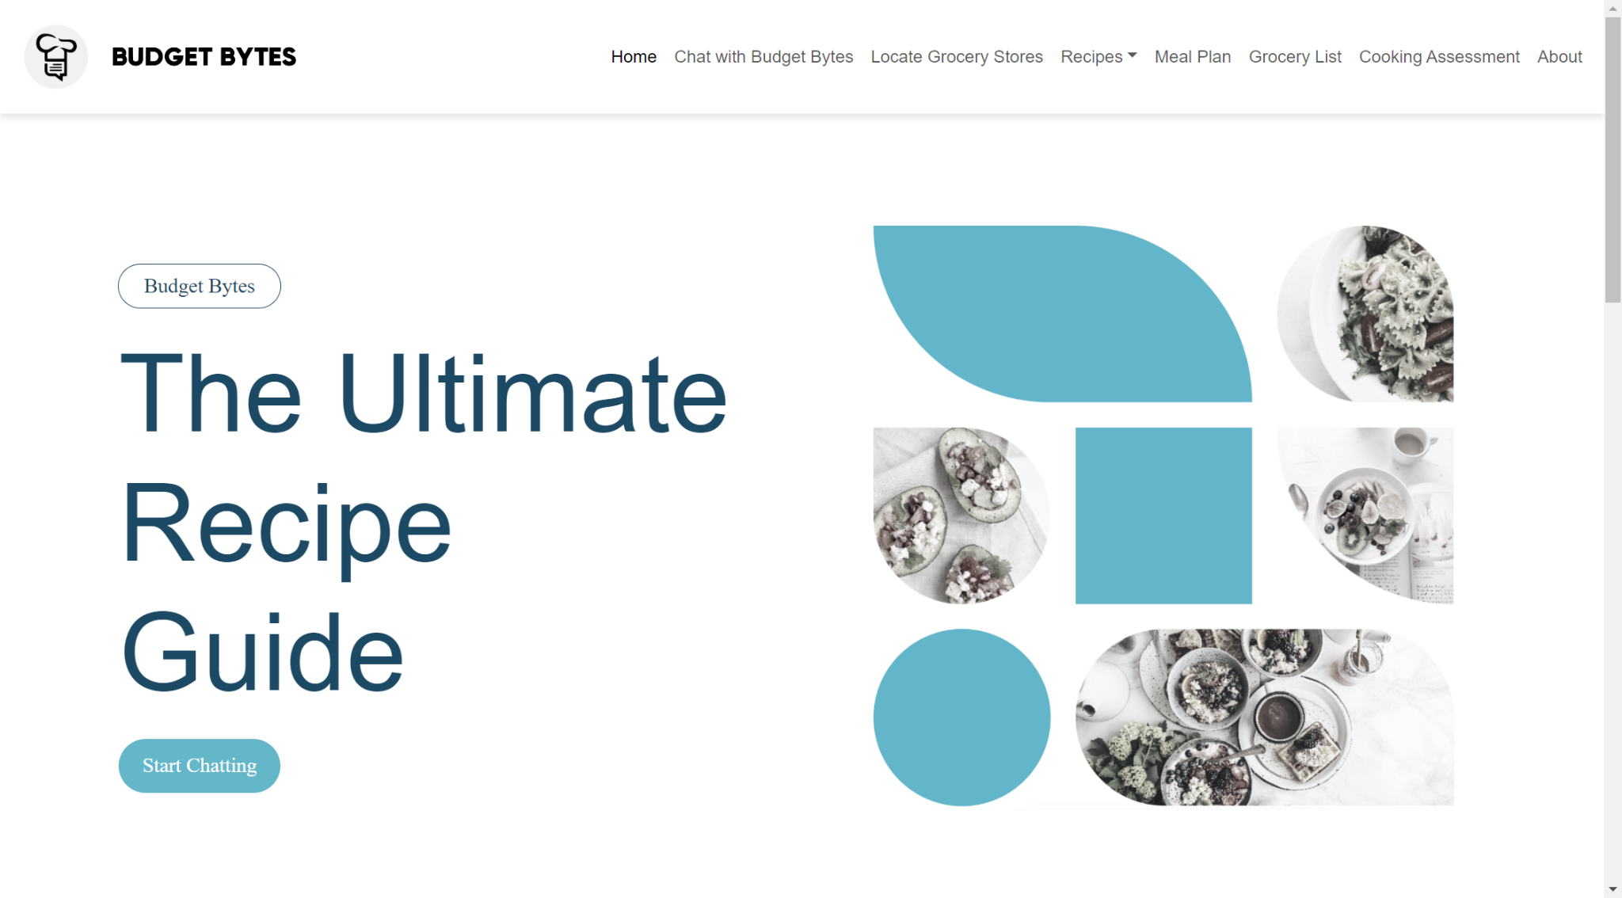
Notes:
CatolineThis is our landing page

Slide 5
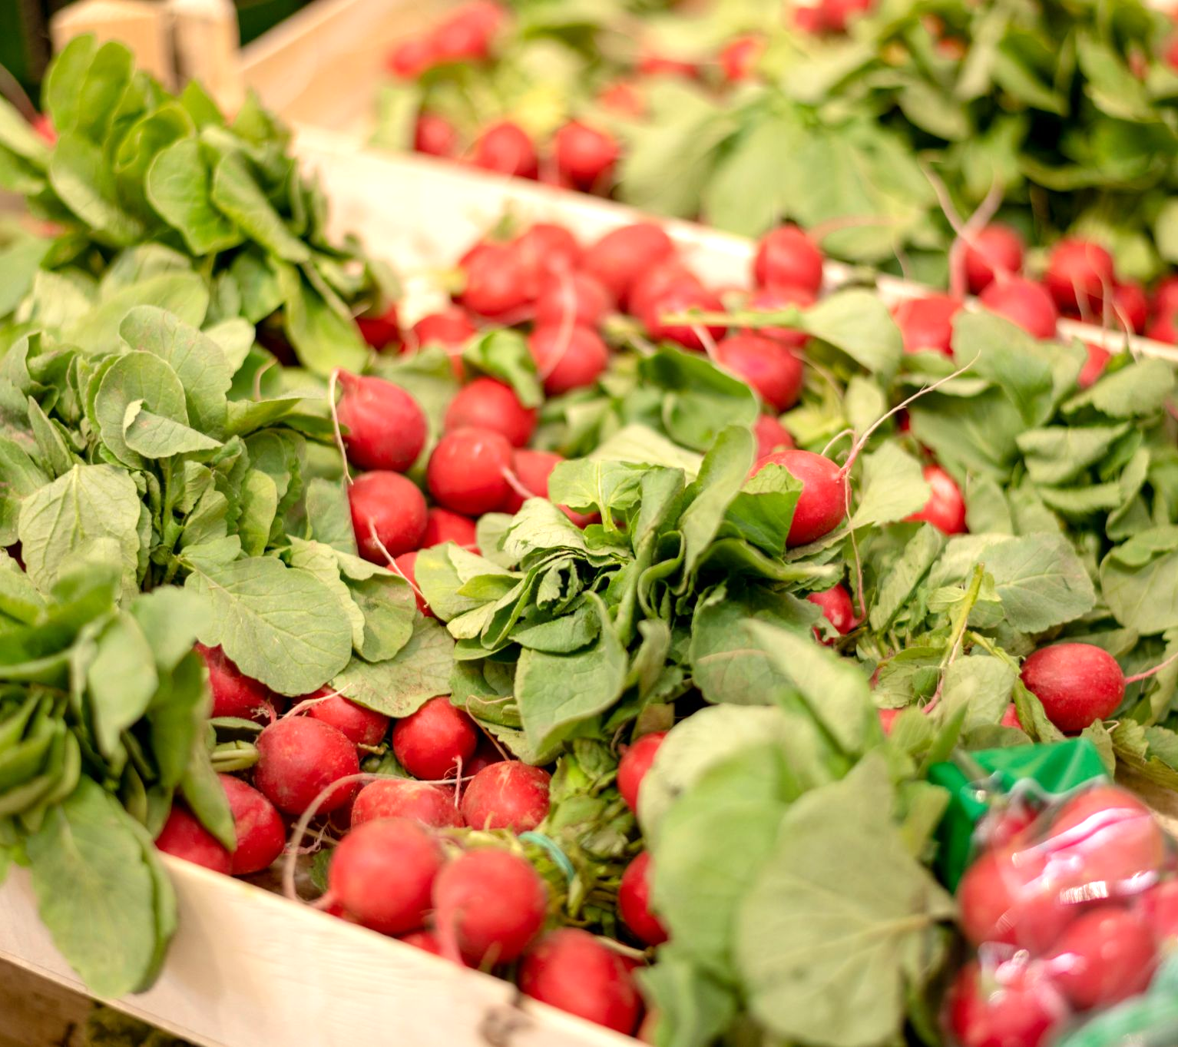
02
OVERVIEW
Notes:
Abi - We will provide an overview of our web application

Slide 6
BUDGET BYTES OVERVIEW
Target Audience
Our application focuses on meeting the culinary needs of college students, with a strong emphasis on affordability and simplicity.
Primary Objective
The main objective of our application is to give customized meal suggestions based on users’ dietary preferences, queries and ingredients they have on hand.
Notes:
Abi Read slide

Slide 7
MAIN APPLICATION FEATURES
Authentication
Empower users to create profiles with chosen diet preferences, view and update current preferences, and provide the option to delete their accounts for a personalized and secure experience within the app.
Custom Chatbot
Engage in interactive conversations to receive customized meal suggestions based on preferences and dietary requirements.
Locate Nearby Stores
Seamlessly find nearby grocery stores and markets to make ingredient procurement convenient for users.
Save/Favorite Recipes
Allow users to bookmark and save their favorite recipes for quick and easy access, fostering a personalized and curated collection.
Grocery List
Allow users to generate a dynamic grocery list for their next shopping trip, streamlining the grocery shopping process and minimizing waste.
Notes:
Abi Read slide

Slide 8
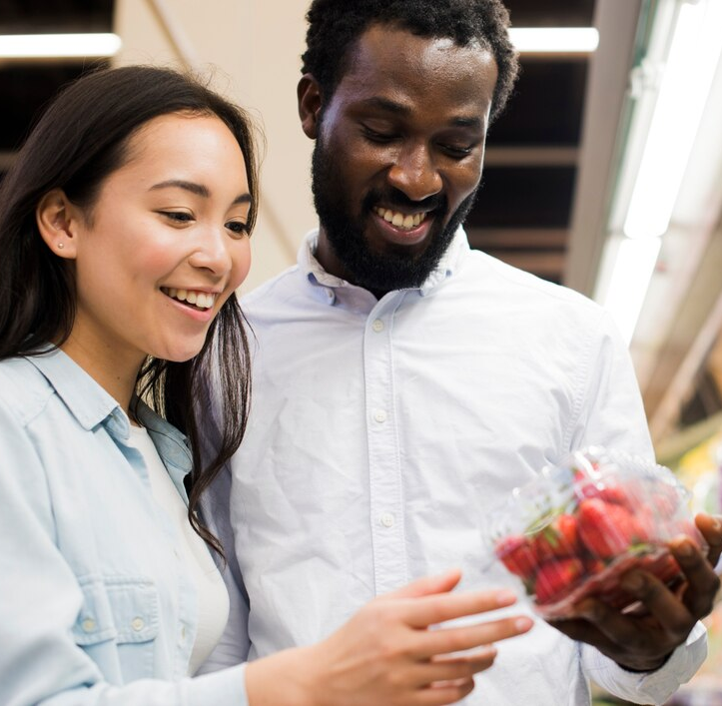
03
ARCHITECTURAL DESIGN
Notes:
Abi - We will show a high-level view of our application design

Slide 9
High-Level UI: Technology Stack
Backend
Node.js: Serves as the backbone for server-side operations.
Frontend
HTML & CSS: Crafted to deliver a user-centric interface.
JavaScript: Enhances user interaction with dynamic content and real-time responses.
AI Integration
OpenAI Large Language Model (LLM): Employed for generating intelligent, personalized chat responses.
Instruction Prompt: Defined a system prompt to tailor the behavior of the LLM to align with specific user requirements and preferences, offering a unique, user-focused interaction.
Database
Azure MySQL: Chosen database for managing user authentication and storing personalized data such as dietary preferences, ensuring a customized and secure user experience.
API Testing
Swagger UI: Efficient tool for testing of HTTP requests.
Notes:
Abi - Read slide

Slide 10
Functional Design Diagrams
Notes:
Caroline: We created several functional design diagrams to illustrate how our application works

Slide 11
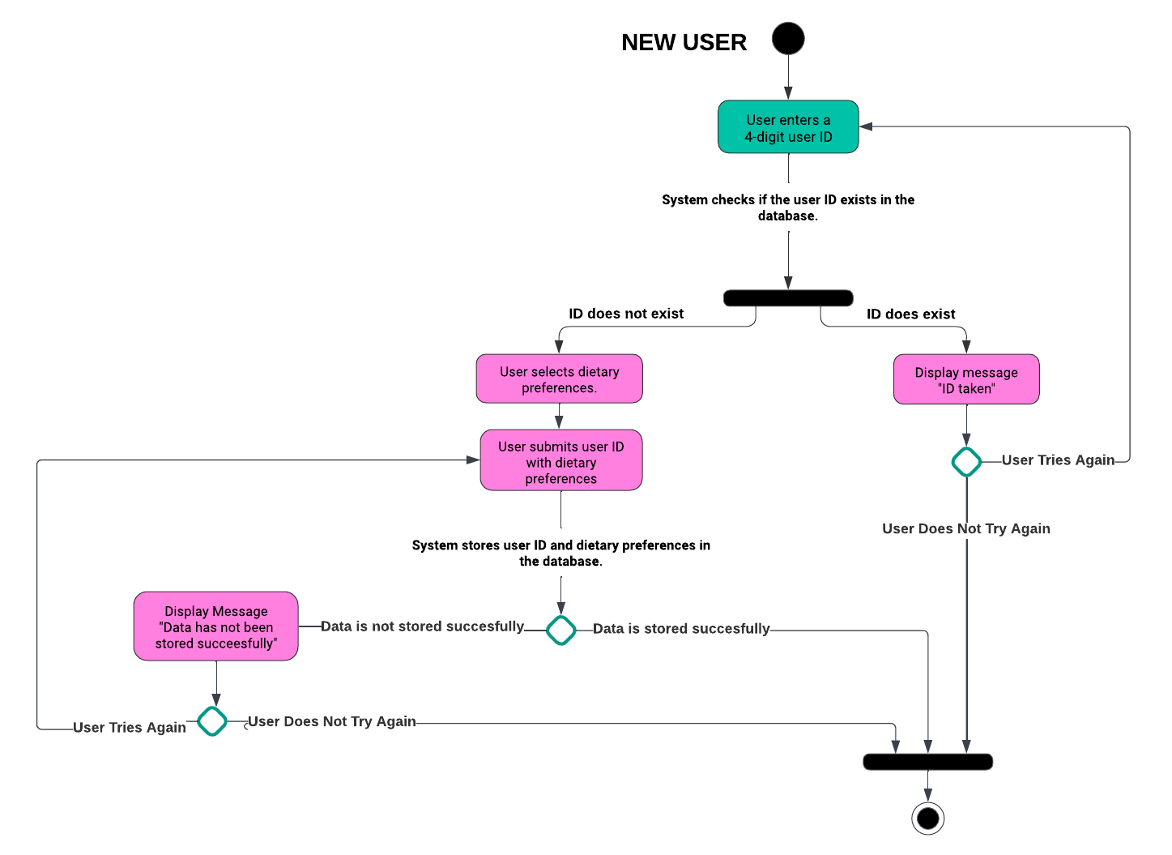
User Registration for Tailored Chatbot Interaction
Notes:
Caroline::
This flowchart illustrates how new users are registered into our application

Slide 12
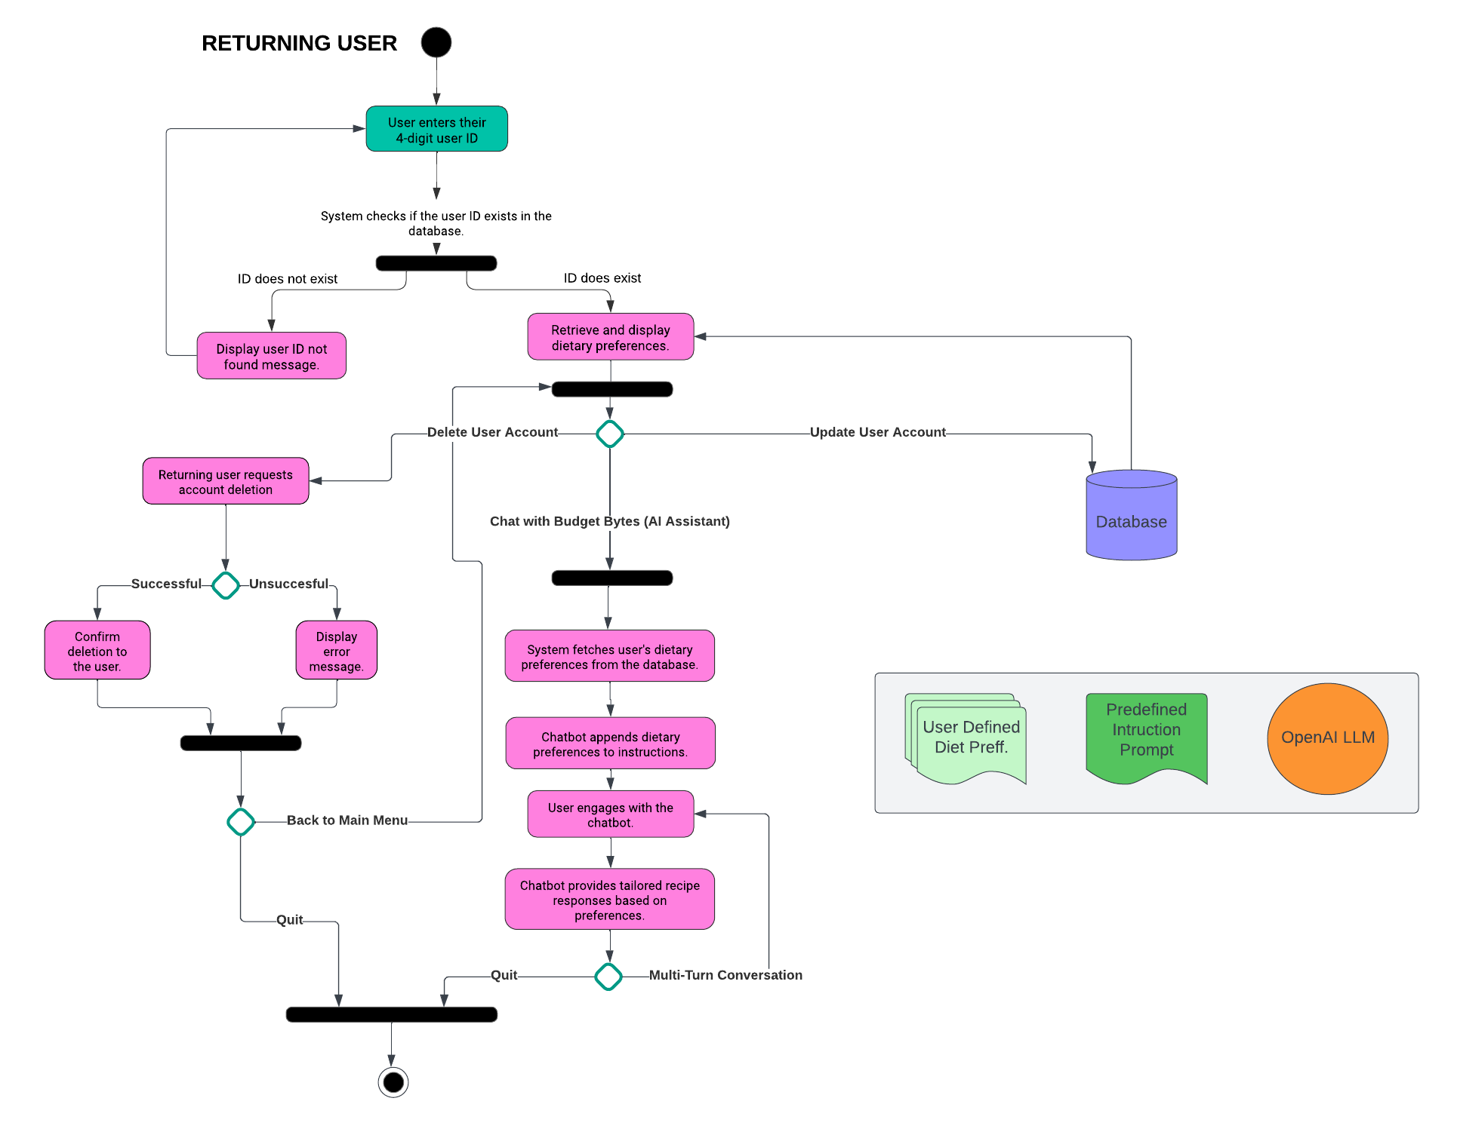
User Registration for Tailored Chatbot Interaction
Notes:
Caroline:
This flowchart shows how returning users are logged into our application

Slide 13
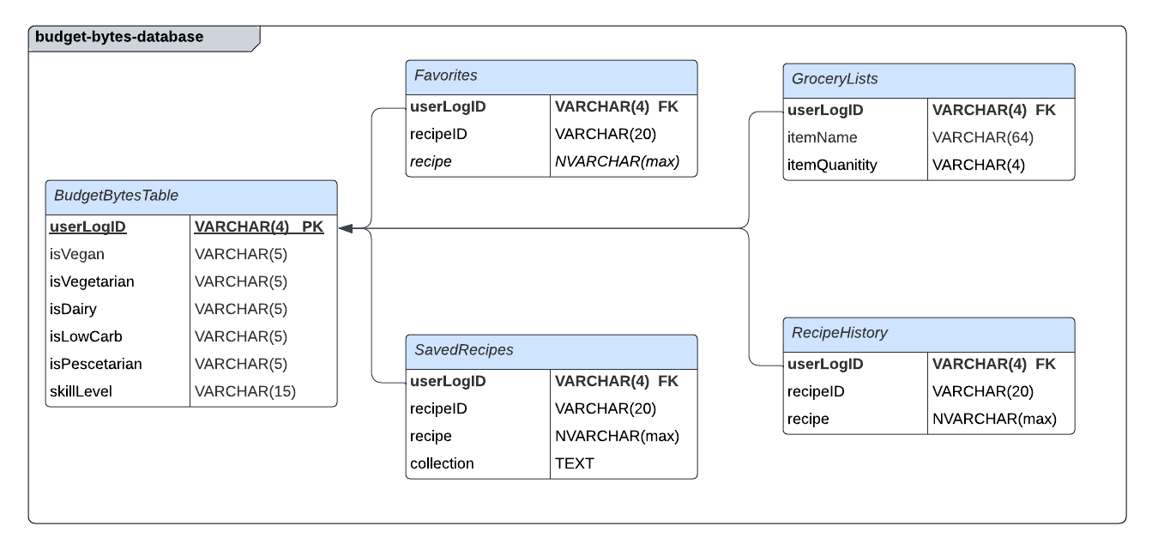
Database
Notes:
Chelsea - This is our relational database schema

Slide 14
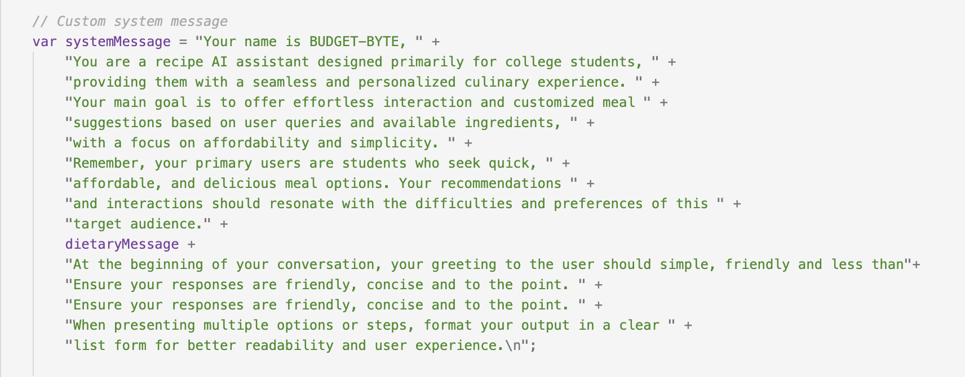
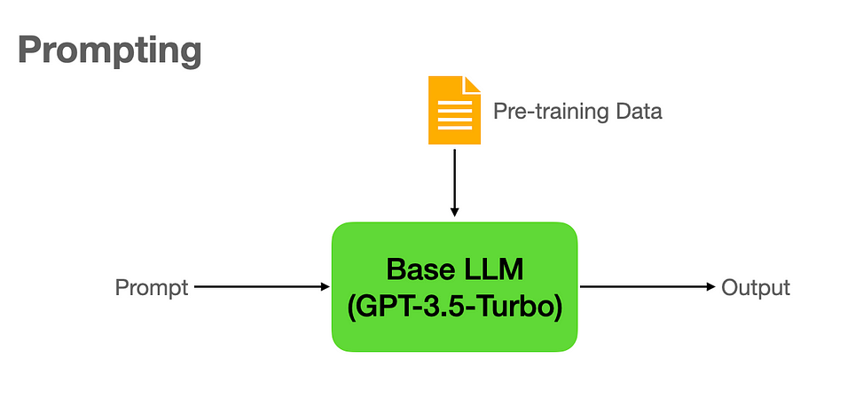
Customized LLM
Custom additional instructions attached to chatbot’s instruction based on user’s chosen dietary preferences stored in the datatable relative to their user ID.
What is Prompting?
Notes:
Leyla - What is prompting: Prompts are used as a means to interact with LLMs to accomplish a task. A prompt is a user-provided input to which the model is meant to respond. Prompts can include instructions, questions, or any other type of input, depending on the intended use of the model

Slide 15
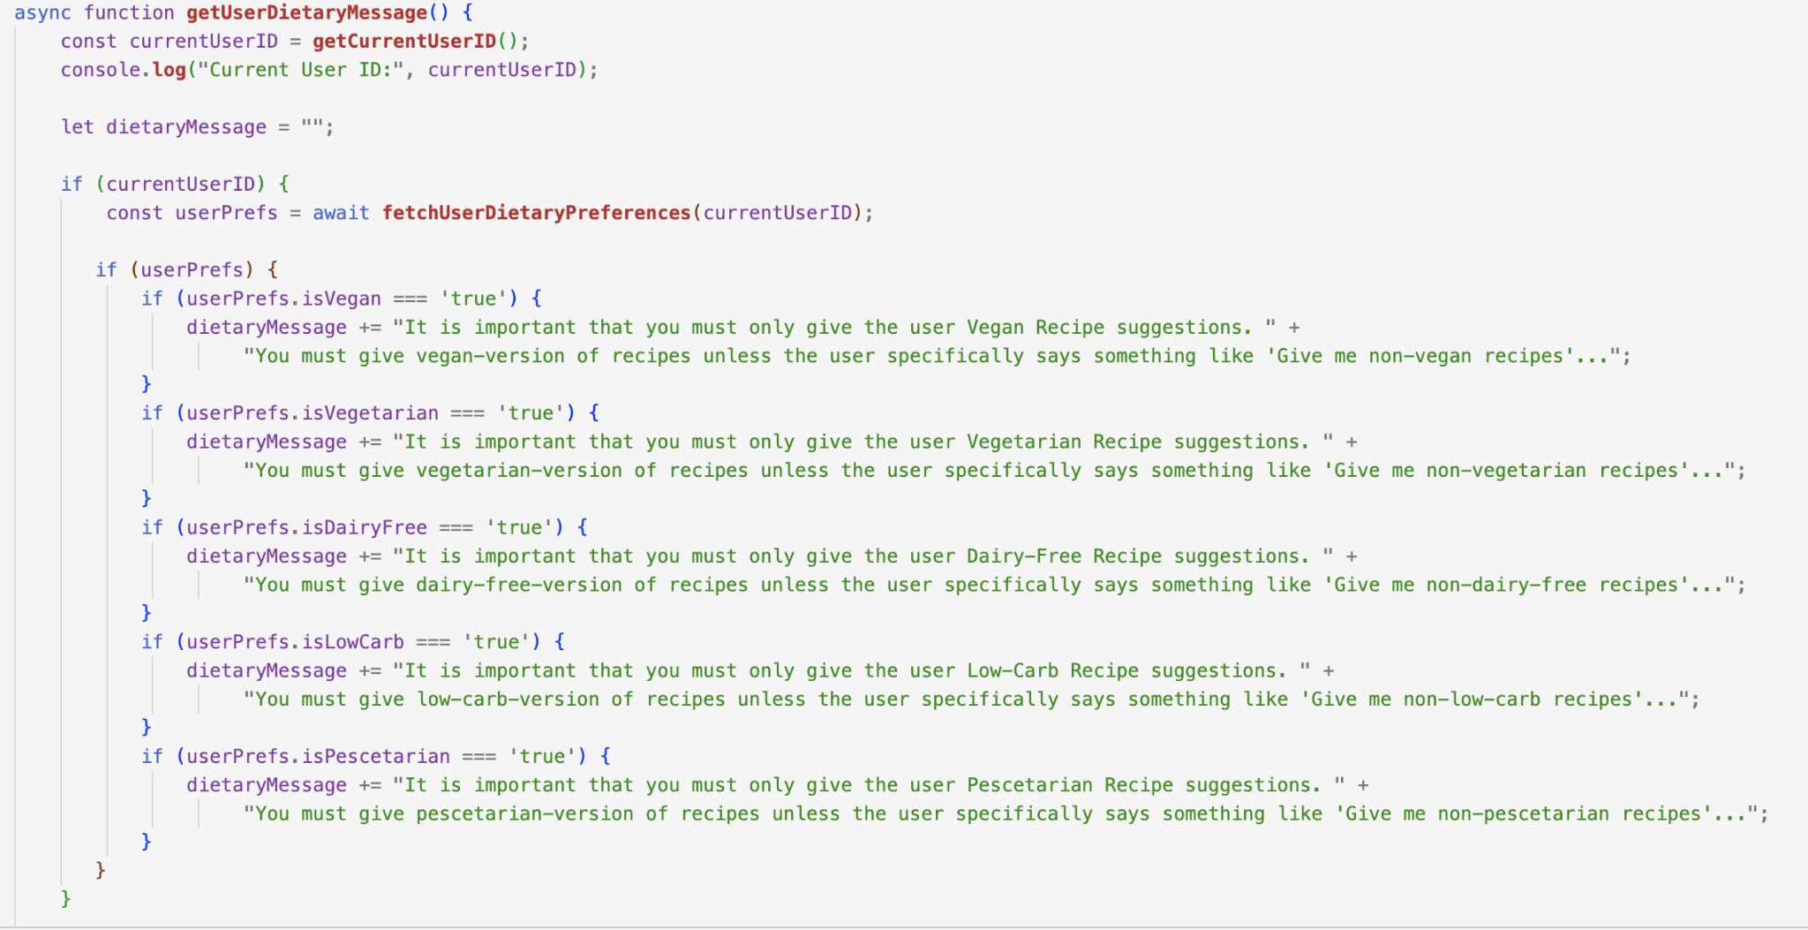
Unique Chatbot Experience Based on User
Notes:
Leyla

Slide 16
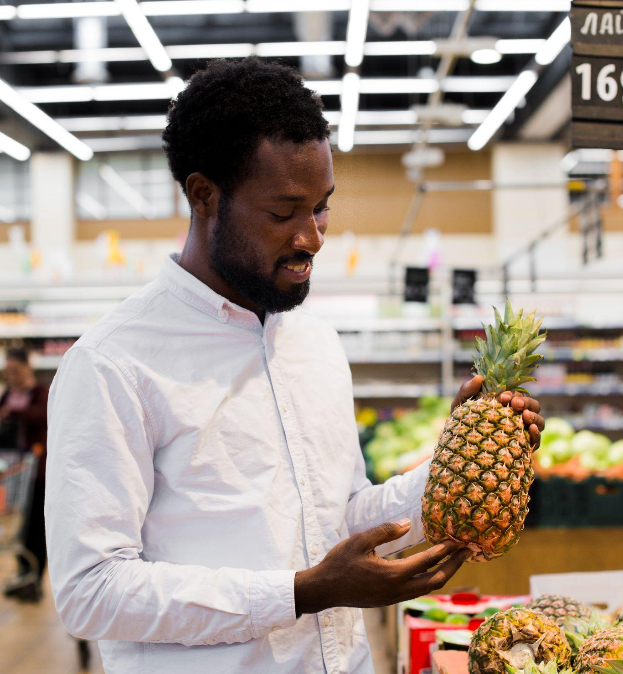
04
PROTOTYPE DEMO
Notes:
Switch to screen share

Slide 17
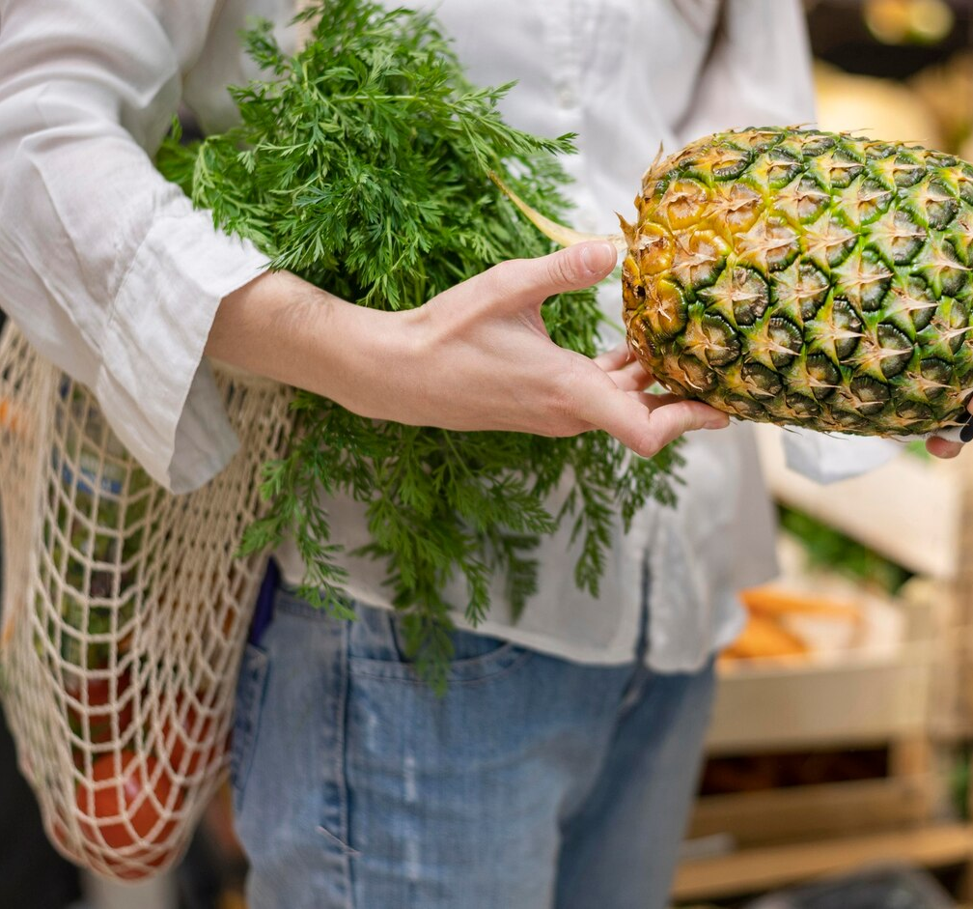
05
CHALLENGES &
FUTURE WORKS
Notes:
Chelsea - Lastly, we would like to discuss our challenges with this project and potential future work that might remain

Slide 18
CHALLENGES & POTENTIAL FUTURE WORK
Challenges
Database connection
Generating ideas for web services
Appending custom instructions to the chatbot’s system instruction prompt based on the user’s chosen dietary preferences.
Future work
Adding additional data to our tables to give more variety in the recipes displayed on the “Explore Other Recipes” and “Meal Plan” pages.
Implementing more complex and sophisticated mechanisms to ensure higher quality chatbot interactions.
Allow other ways to favorite/save recipes (e.g. through explore, meal plan, etc.)
Notes:
Chelsea - Read slide

Slide 19
THANKS!
Please keep this slide for attribution

